Slide 1
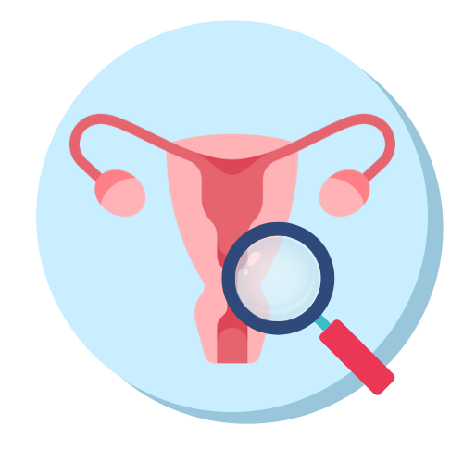
Endometriosis Early Detection
Daniel Moshe | Adi Haber
Notes:
Adi
We came to present the progress of our research

Slide 2
Workshop Overview
Analyzing medical data found in UK Biobank using machine learning tools.
Research Question
Creating a Cohort
Defining a research question regarding risk factors of a certain medical condition.
Creating a cohort of patients relevant to the research question and cleaning it.
Extracting Features
Creating a Model
Examining various medical studies and scientific articles to find features. Then extracting them from the UKB.
Creating a machine learning model to get a prediction for the research question and repeating the process to improve it.
Notes:
Risk factors
Biobank structure

Slide 3
Our Research Question
What are the key risk factors associated with the development and diagnosis of Endometriosis?
Notes:
Risk factors
Biobank structure

Slide 4
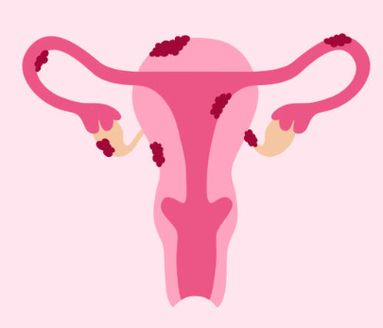
What Is Endometriosis?
A chronic medical condition where endometrial tissue grows outside the uterus and adheres to other organs, mainly in the pelvic region.
Main symptoms include chronic pain, infertility, fatigue, and sometimes even anxiety and depression.
Endometriosis is prevalent mostly in women of reproductive age (15-49). Researchers say 10% of this population is affected - about 190 million patients worldwide.

Slide 5
Reasons for Choosing this Subject
Endometriosis is under-researched, with significant gaps in understanding its causes, risk factors, and optimal diagnostic methods.
The diagnosis process is long and tedious.
There is a lack of awareness to this illness, both from the general population and medical professionals.
Notes:
- in the UK, more than half of people do not know about endometriosis, including 62% of women between the age of 16 and 24 (BMC Medicine. Shining a light on endometriosis: time to listen and take action.)

Slide 6
The Problem
Diagnosis dificulty
Effects of delay
Current state
Endometriosis is very hard to diagnose.
Adhesions are hard to see using imaging.
Diagnosis time averages at 7 years.
Intensifies symptoms.
Lowers quality of life.
Causes incurable reproductive health challenges and infertility.
Conventional diagnostic methods include invasive procedures.
Doctors have subjective assessments.
Notes:
60% of women dealing with endometriosis will experience a delay of seven years before getting a diagnosis.
This prolonged delay intensifies symptoms, lowers overall quality of life, and contributes to enduring reproductive health challenges.
Conventional diagnostic methods, predominantly reliant on invasive procedures and subjective assessments, further complicate the diagnostic process.

Slide 7
Proposed Solution
Diagnosing Endometriosis by analysing UK Biobank patient data.
Developing a machine-learning model for precise Endometriosis detection using these features extracted from the UK Biobank.

Slide 8
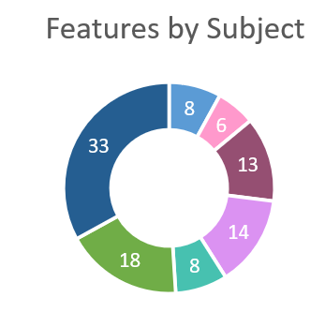
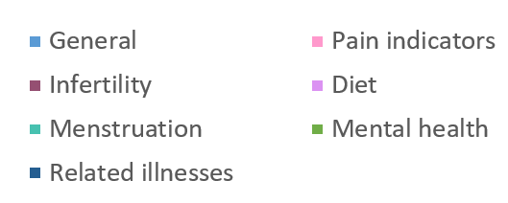
Extracting Initial Dataset
We created a list of 100 features by feature id, from the UK Biobank Showcase.
They include general data, pain indicators, infertility and pregnancy difficulties, diet, menstruation, mental health and related diseases.
Coding a generic library for feature extraction.

Slide 9
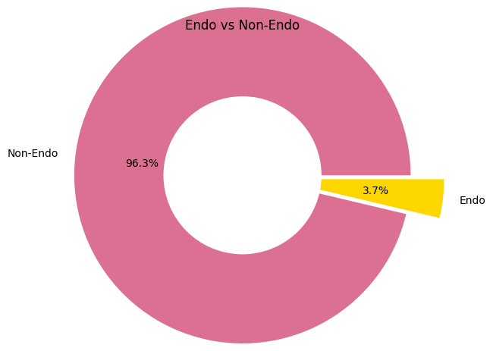
~270,000
~10,170
Exploring our Data
Female patients in the biobank
Patients diagnosed with Endometriosis

Slide 10
Dilemmas and Challenges
Diagnosed Ratio
Train and Test Sets
The dataset has about 4% diagnosed patients, while the diagnosis ratio in the general population ratio is 10%.
What should be the ratio of Endometriosis diagnosed patients and healthy patients in our datasets?
Diagnosis Age
Undiagnosed Patients
The average diagnosis age in the dataset is 42, while the average woman will be diagnosed in her 30s.
Will this affect the age as a feature?
Which of the non-positive patients should we choose for our train set? Exclude patients with other gynecological conditions?
Notes:
- Only 2% of population diagnosed with endo, not representing of the true distribution in the population
Probably because its an older population, and older data
50-50 on train set, 80-20 on test set. We will decide on validation split based on the model we choose

Slide 11
Roadmap
01
02
03
04
Choosing and defining reaserch question
Research Edometriosis and find features
Code scripts for data extractions
Extract initial dataset
05
06
07
08
Explore and cleanse data
Feature engineering
Choosing model
Evaluation of the model
Notes:
Next is feature engineering
The uKB offers a lot of data, one of the files is hospital diagnoses
Endo is hard to diagnose, and its symptoms are very similar to other conditions. This, combined with the diagnosis delay, causes many mis-diagnoses along the way
Thus, we assume there will be a correlation between endo and the number of diagnoses.

Slide 12
Thank you
Endometriosis Early Detection | Daniel Moshe, Adi Haber

Slide 13
Endometriosis is a chronic condition where endometrial tissue grows outside the uterus, causing pain and infertility.
Endometriosis is difficult to diagnose. diagnosis is reached with an average 7-year delay, often requiring invasive procedures.
A machine learning model to identify common risk factors and predict endo.
The Features:
Pain
Infertility
Diet
menstruation
related conditions
The Patients:
Female
Reproductive age
10,000 diagnosed with endo

Slide 14
Data Extraction
Create Cohort
Feature Preprocess & Engineering
Choose Model
Data Extraction
Create Cohort
Feature Preprocess & Engineering
Choose Model
Research
Research
Data Extraction
Create Cohort
Feature Preprocess & Engineering
Choose Model

